Slide 1
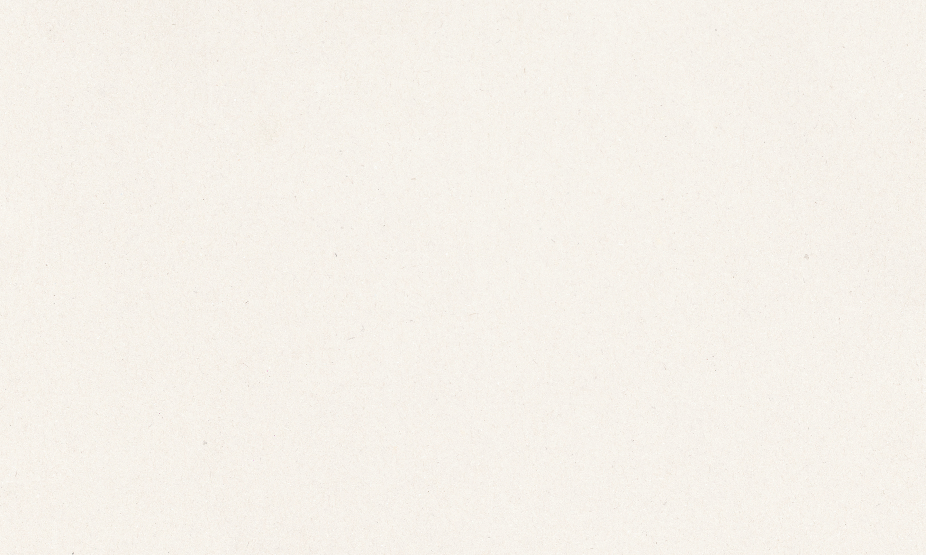


WINTERFELL.DEV
TASTE IS THE
NEW MOAT
How Winterfell was built end-to-end, and why taste matters more than ever
PRESENTED BY:
PRESENTED TO:
Rishi Kant
Bootcamp 1.0

Slide 2
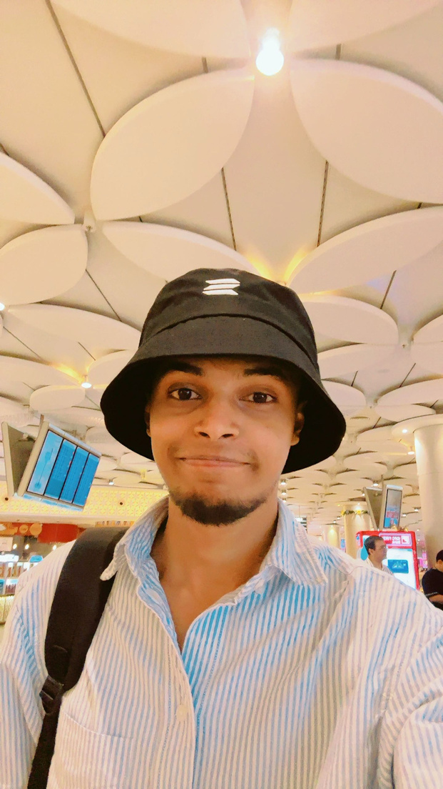
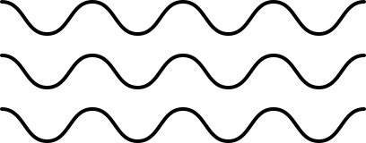
02/15
Rishi Kant.
Strong bias toward polish, scalability, and real-world constraints
Recently built Winterfell and won a Superteam hackathon worth 1000$
Builder focused on end-to-end systems, not just UI demos
This session is not about craft, it’s about approach
and taking ownership while building applications

Slide 3

03/15
The AI Era
AI can now replicate nearly everything. Be it design, frontend, backend development, you name it. There's an intense debate online about whether human engineers are still necessary, or if AI has made the entire field obsolete.
so like what has left ?

Slide 4
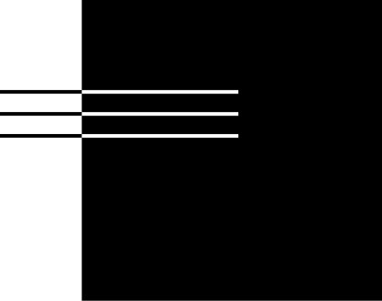
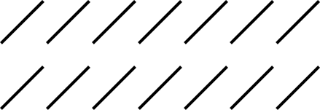
04/15
* | Edge cases
* | Micro Interactions
* | Performace
* | Thoughful defaults
* | The Do it Now Mindset
* | ui /ux and DX
The 1% Difference
which adds the
Butterfly Effect

Slide 5
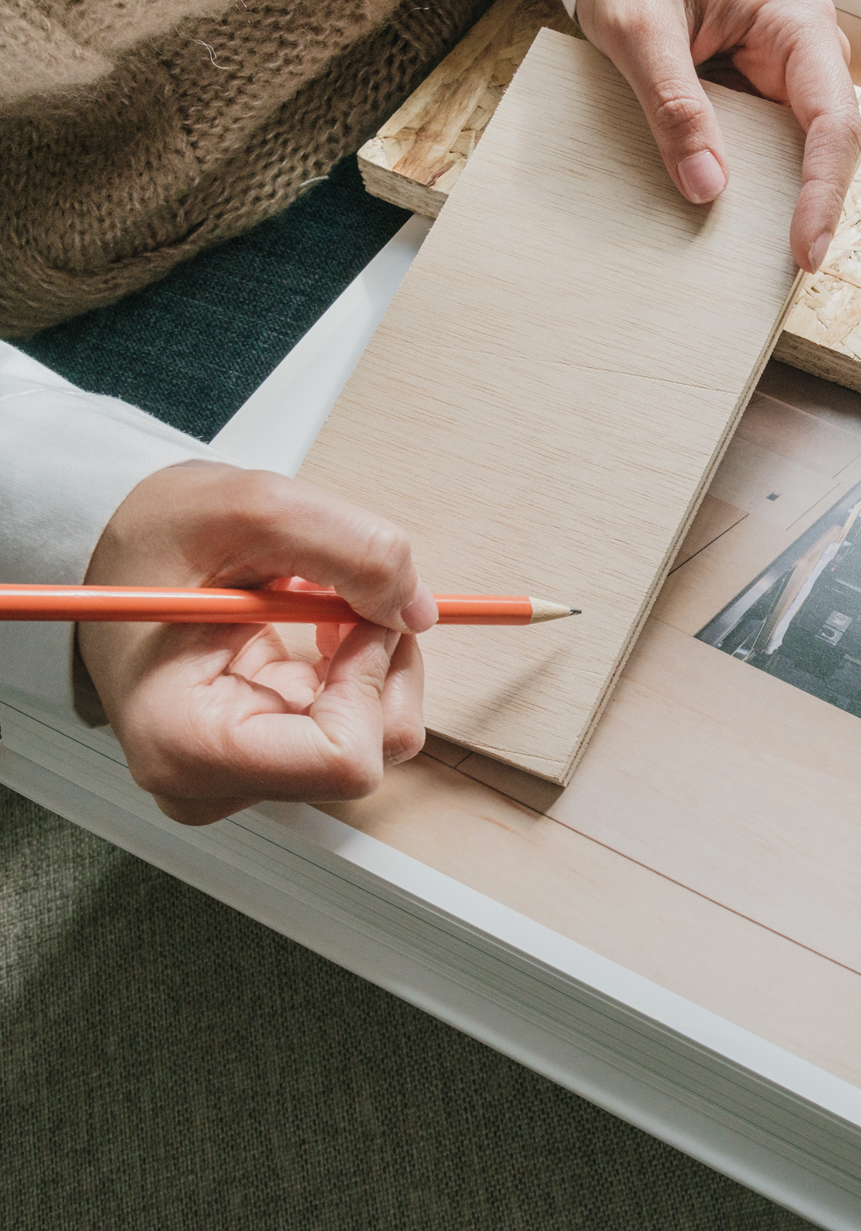
Project
Product
01
An application which was built to just showcase its purpose
01
An application which is been built in away that real users will kick in and smash it
02
Bugs and improvements are “next sprint” problems.
02
"In a product mindset, you take ownership of quality at every level. You don't just ship code that 'works', you refine it until it truly serves users well. This means spending time on details others might dismiss
03
Shortcuts are taken to hit the deadline
03
Thinks in terms of scalability, maintenance, and evolution.

Slide 6
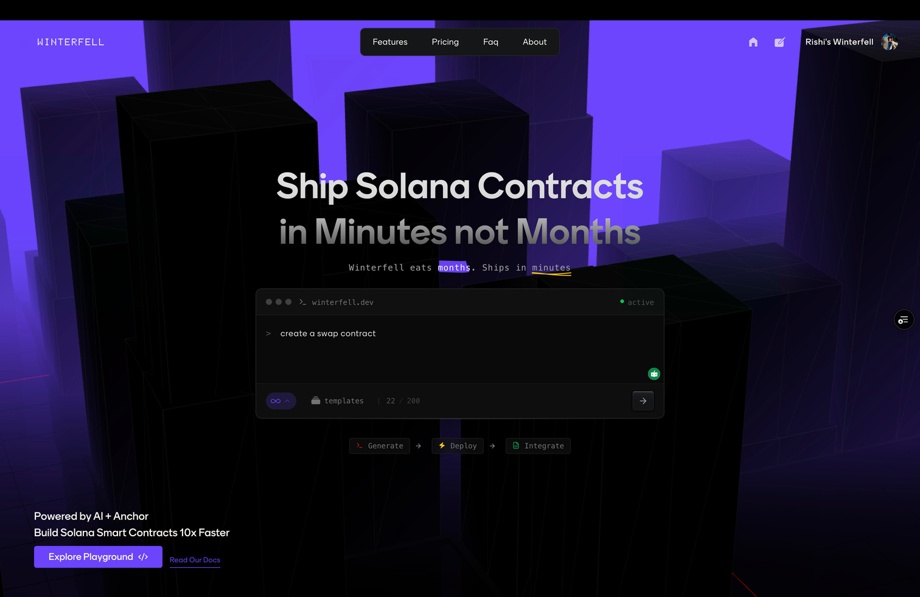
06/15
THE WINTERFELL TIMELINE
The idea originated in early September while attending a Solana ecosystem event in Mumbai, organized by Superteam and Apex.
Seeing teams build deep Web3 infrastructure—some scaling from early-stage projects to billion-dollar revenues—was a major inflection point.
On 7th September, during a 100x class, we were discussing the architecture of Lovable and how such applications are built.
During that session, Kirat proposed the idea that if someone can build Lovable but for Anchor smart contracts, that would be a good fit for the Colosseum and Superteam hackathons.
The class ended at 7:30 PM; by 8:30 PM, the repository was live, the database was set up, and authentication was in place.
Everything you are seeing on the app screen has been built in a span of 23 duays.

Slide 7
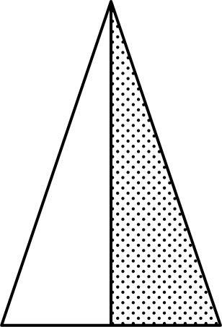
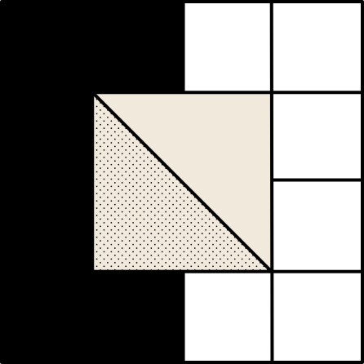
Understand the user journey map
07/15
always think about the user journey map,
Getting inside the application
Playground
Since the core audience are developers and the product requires code checkout, GitHub sign-in is the primary authentication method we supported. To support non-developer users, Google sign-in is provided as a fallback.
This is where users experience the true value of the application by actively using the product.
Things like loading, skeletons and retry logic on fails should be there, even a minute edge case can F up the whole experience
Traction: Onboarding / Entry Point
Discovery
Here users learn who we are as a business and what we aim to deliver by exploring key features through clear and intuitive navigation.
Retention & Trust Signals
If users feel stuck or annoyed even once, you’re kinda screwed. Very important stage, try to take reviews. Make sure the you was able to deliver what user has came for
Users enter Winterfell primarily through developer-centric channels.

Slide 8
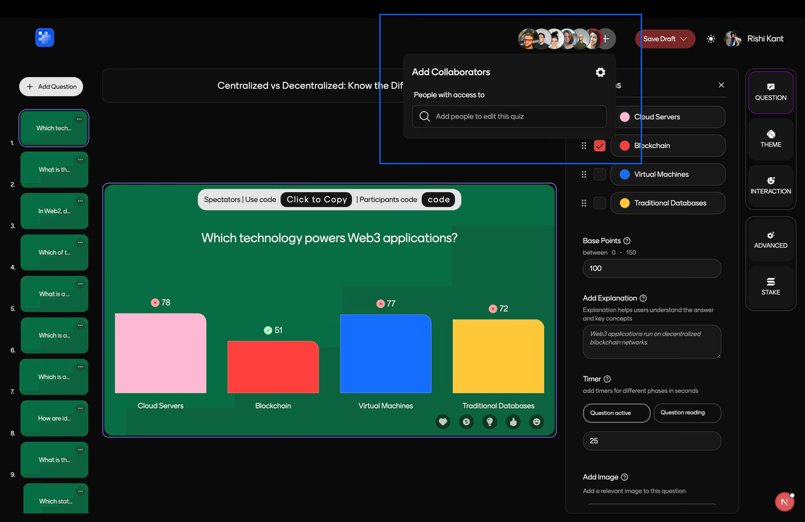
08/15
THE ICEBERG PRINCIPLE
What appears to be a simple “add collaborator” feature actually hides several important considerations beneath the surface:
Generally we as a developer neglects that, but should we ?
Is the email being added associated with a real user on the platform?
If it isn’t, how should the system handle that case—invite flow, error, or pending state?
If it is a valid user, should they be added immediately or only after they explicitly accept the request?
link to the gist
To keep the user experience seamless and the onboarding truly frictionless, these checks are essential, even if the feature appears simple on the surface.

Slide 9
09/15
Good design feels obvious, users dont have to think too much
Spacing
Typography and colors
Use more spacing, not more content.
Good websites dont feel crowded.
Even on a screen-sized section, layout should feel clean, text should be readable and the elements shouldn’t fight for attention.
Minimal design is a personal choice.
What does minimal mean though? Minimal isnt empty, it is only thats necessary.
White space is not wasted space. It’s what makes design readable.
Why use spacing?
It is what helps users to focus on one thing at a time. (Good UX)
Typography is visual hierarchy.
What users should see first, what should they see next and so on.
How do you take care of this?
It depends upon font-size, font-weight, font-color and positioning.
Colors (important)
A limited color palette maintains the vibe and consistency of the website.
Colors drag attention before text does.
Keep animations minimal, think of it as communication and not decoration.

Slide 10
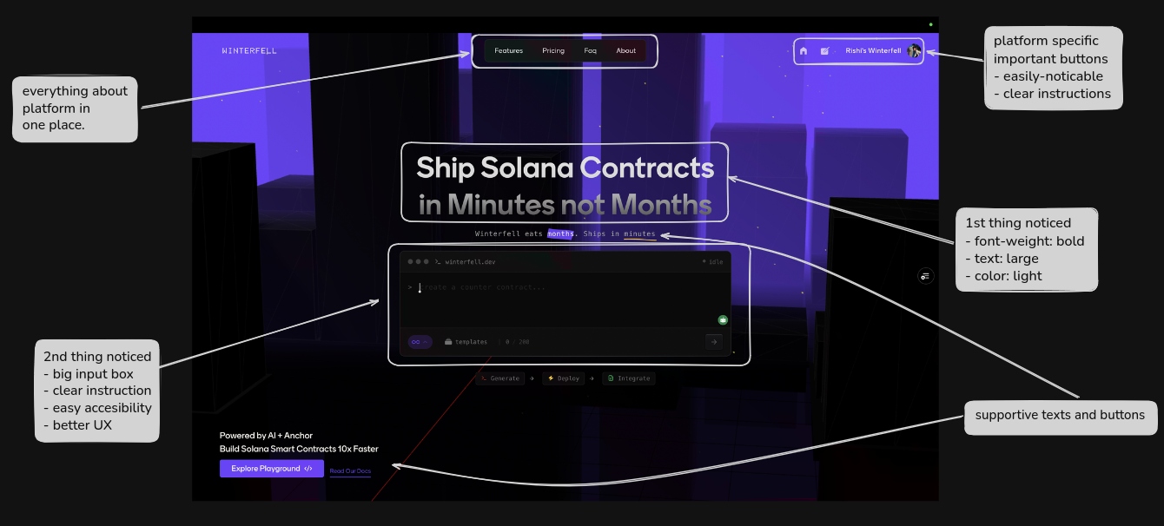
10/15
If a user has to think too much, the design has failed.

Slide 11

11/15
Is Taste a personel preference
What do you guys think ??

Slide 12
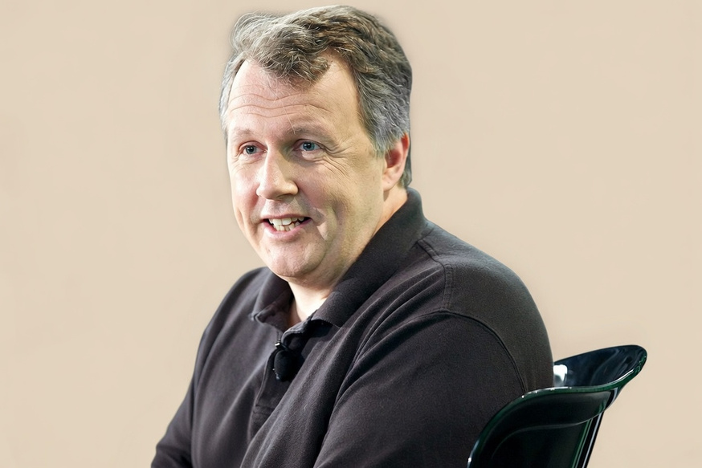
12/15
TASTE IS NOT PERSONAL PREFERENCE
If taste IS JUST PERSONAL PREFERENCE,
THEN EVERYONE’S TASTE IS ALREADY PERFECT.
- paul graham (co-founder yc)
So how do we develop it ?
A good habit to keep with yourself is
From now,
Explore websites not from a user eye only,
but from a developer eye, that hey I like this
design, seems interesting, will add it in my next project
Basically you can train yourself with the intent, it can’t be imposed
or downloaded

Slide 13
Taste is not just preference
13/15
Designing is not a skill, it’s an art and thoughtful defaults
Inspiration
Decode
Internalize
Refine
scroll products,
not projects
understand their behaviour
rebuild those interactions
remove the unnecessary clogs and make the application own it, even if it is copied
creating a design is just an imagination,
real execution happens when the design is optimized and scaled
Remember, you not always need a Figma file
to go ahead.

Slide 14
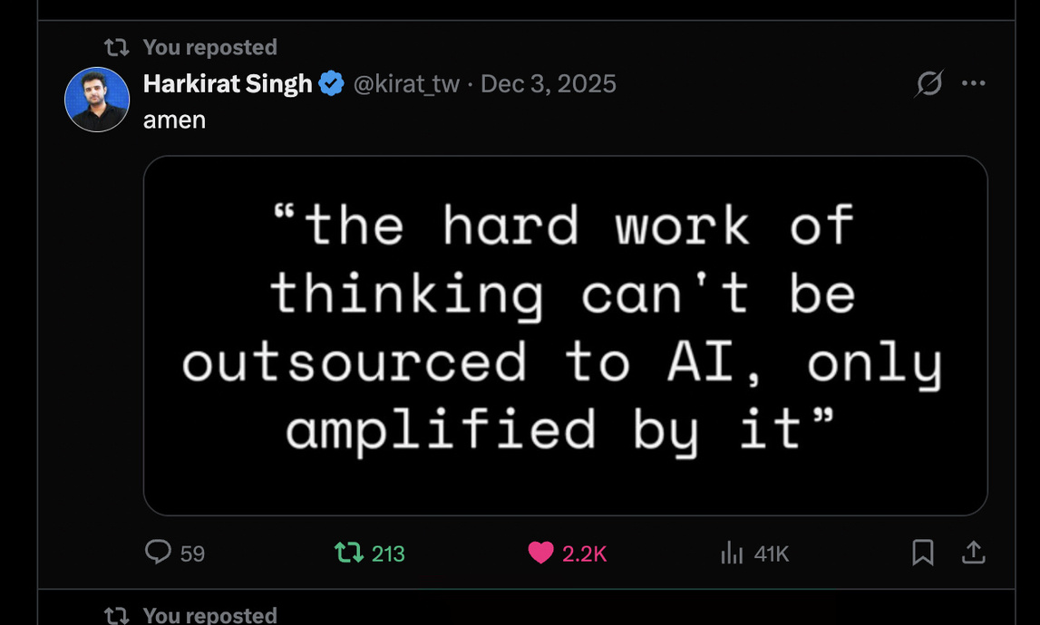
Learn to write clean code, not just UIs.
And learn to write it with Bare Hands
14/15
STOP USING CURSOR OR ANY AGNETIC TOOLS, ATLEAST WHEN YOU ARE LEARNING SOMETHING..
ITS LIKE A VERY UNIQUE SKILL WHICH PEOPLE NOWADAYS DONT HAVE BECAUSE THEY HAVE CURSORED ALOT THAT A SINGLE FILE IS CONTAINING AROUND 2800 LINES OF CODE WITH EMOJIS IN THE COMMENTS.
EVEN A SINGLE LINE OF CODE IS LIABILITY
NO ONE CARES ABOUT THE SKELETON IF THE BODY IS SKNINNED,
UI IS THE VOCAL CHORD OF THE APPLICATION

Slide 15
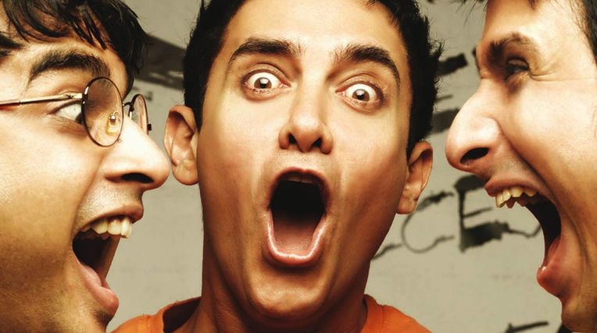
15/15
REMEMBER
IN A WORLD OF SCARCITY, WE TREASURE TOOLS
IN A WORLD OF ABUNDANCE, WE TREASURE TASTE
Today, almost everyone has access to powerful tools. What sets people and products apart is not the tools themselves, but the judgment, design sense, and decision-making behind how those tools are used.
github.com//bottle-nex/winterfell
QUALITY KE PICHE BHAGO
DESIGN JHAK MAARKE PICHE AAYEGI
Github: @kant-github Twitter: @khairrishi

